Slide 1
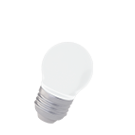
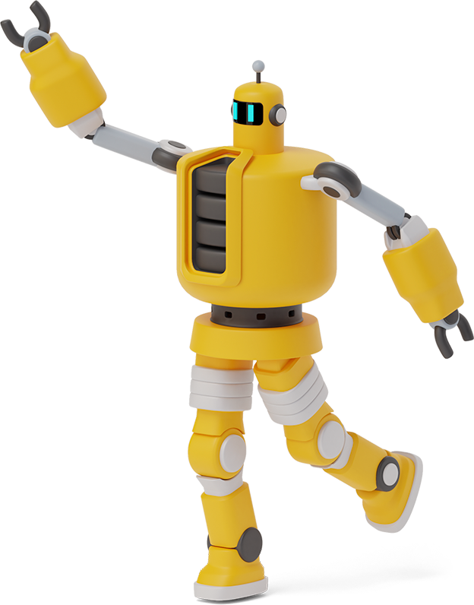
Python Playground

Slide 2
Roadmap
Review of Last Week
Integers, Floats & Strings
Variables
1
3
5
2
4
6
Class Activity
Expressions and Statements
Class Activity

Slide 3
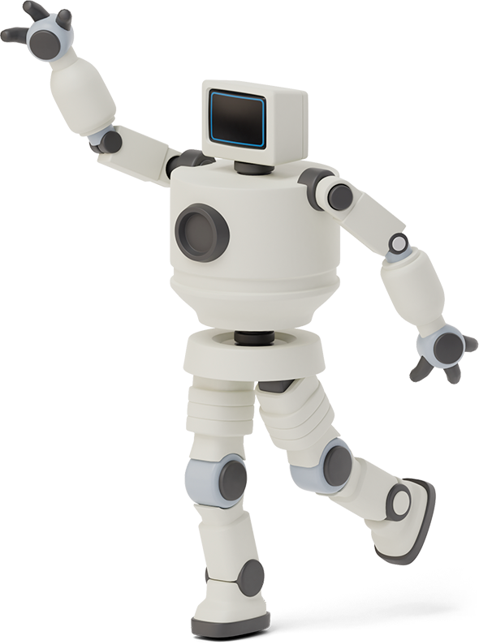

Review of Last Week
Python is a high level programming language
You can use python through colab.google
What is syntax?
What is a string in python?
Difference between integer and float?
How do we use the print function?
How do we leave comments in python?

Slide 4
My first program in python

Slide 5
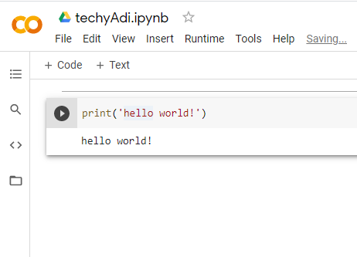
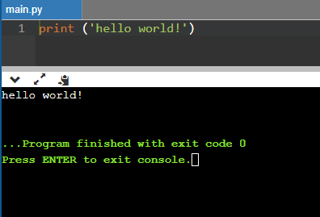
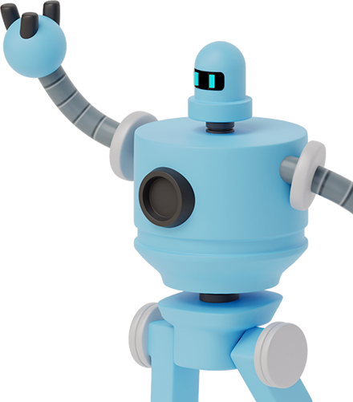
Code
print(“hello world!”)

Slide 6

Knowledge Check!
Print function
Print your name and age in Google Colab
Addition
Add 5 + 5 in Python
Subtraction
Subtract 10 – 5 in Python
Division
Integer division on 13 and 2
Float Division on 13 and 2

Slide 7

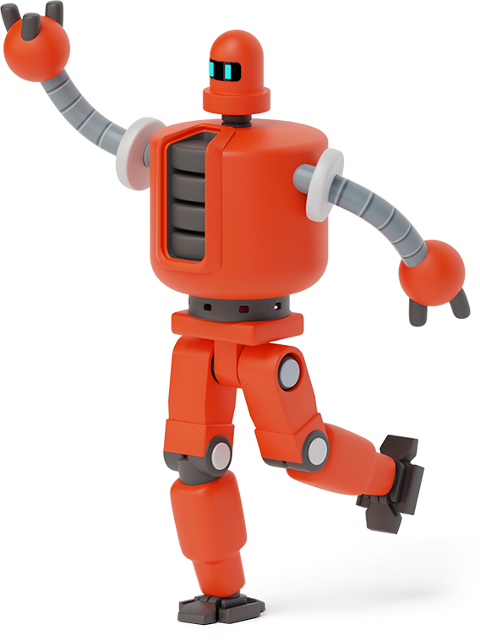
Integers, Floats, & Strings
Recall that integers are whole numbers
Examples: 1, 2, 3, 10, 100
Floats are numbers with a decimal
Example: 1.5, 2.7, 5.3, 100.9
Strings are unique!
They can involve both numbers and words
Example: “I am 10 years old”

Slide 8
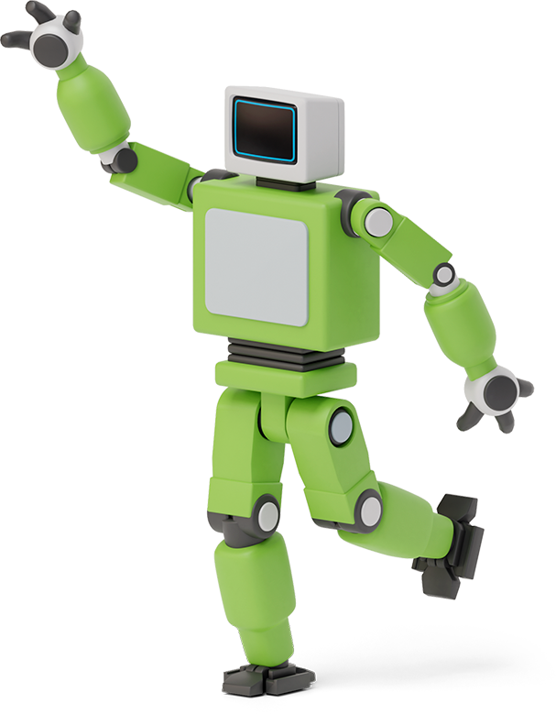

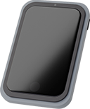
Expressions
Recall, operators are used for math operations (+, -, *, **, /, //)
An expression is a collection of operators and numbers
Example: 6+6, 6*6, 6-6, 6/2, 6//2

Slide 9
Statements
A statement is a piece of code that does something (an action)
Example: a = 10
Statements are needed in Python to create programs!

Slide 10
variables
Reserved memory locations to store values

Slide 11

How do we use Variables in Python?
A Python Variable is a name that is equal to some value
Variables cannot begin with a number
Variables are case-sensitive (lower case only)
Use the equal sign to assign a value to your variable

Slide 12
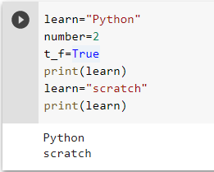
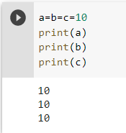
Using variables in python
Assignment operator (=) is used to assign a value to a variable.

Slide 13
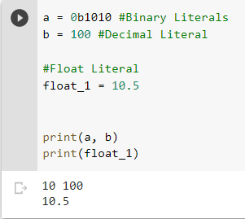

Data Types in python
String: sequence of characters surrounded by quotes.
Numeric: they are of three types:
Integer
Float
Complex
Boolean: It can have only two values (true/false)

Slide 14

Class Activity
print(5 + 2)
print(10 - 4)
print(3 * 7)
print(10 / 3)
print(10 // 3)
print(2 ** 4)
Using Variables
1. Set a to 5
2. Set b to 10
3. print(a+b)

Slide 15
Thanks!
Any questions?

